Slide 1

Coding for strangers
Scotland 23/05/2017
@UKSthCoastPSUG
@ScotPSUG

Slide 2
Four ways to use powershell
Console
Script
Module

Slide 3
console
Interactive
Ideal for testing

Slide 4
script
Complex tasks

Slide 5
modules
Sponsor – we have one!
Without one it will cost around £150 to host each meetup
Speakers
Some lined up, discussions ongoing
At least one person, ideally two, to help me run the group

Slide 6
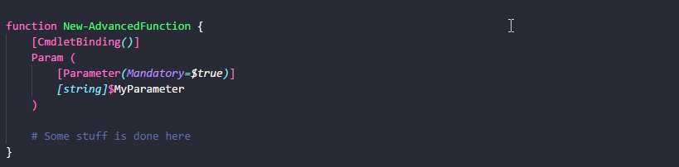
functions
Define advanced function using:
Allows your function to accept -Verbose, -Debug, -WhatIf, -ErrorAction and others.
Use get-help about_Functions_Advanced

Slide 7
SAVE PLANET CODE – GO GREEN
Reduce
Code size reduces
Readability increases
Code Size
Readability
Complexity
Maintainability
Complexity reduces
Maintainability increases

Slide 8
SAVE PLANET CODE – GO GREEN
Reuse
Focus narrows
Reusability increases
Focus
Reusability
Unreliability
Reuse
Reuse increases
Potential for bugs & unreliability decreases

Slide 9
SAVE PLANET CODE – GO GREEN
Recycle
Focus narrows
Reusability increases
Focus
Reusability
Unreliability
Reuse
Reuse increases
Potential for bugs & unreliability decreases

Slide 10

Commenting your code
Code should almost comment itself
Use Write-Verbose to comment your code
Displayed on the host when the function is called with the –Verbose parameter
Describes your code as you go
Comment for somebody else
You know what it does and how it does it, the rest of the world does not!

Slide 11

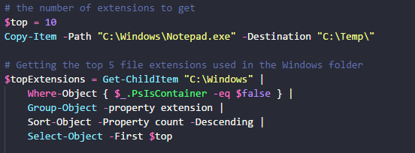
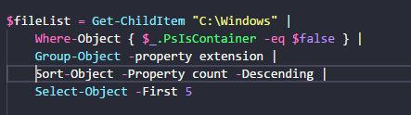
Commenting contentment
Comments should not explain the obvious
Comments should be used to explain the not-so-obvious

Slide 12
Help ON HELP
Says what your code does
.SYNOPSIS
.DESCRIPTION
Says what parameters are available, how and required
.PARAMETER
Gives a demo of how to use the code
.EXAMPLE
Add help to each function you write as you go along – don’t pretend you will do it later!

Slide 13
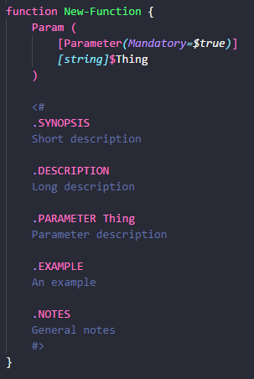


WRITING help
As a minimum add:
.SYNOPSIS
Tweet length description of your code
.PARAMETER
One for each parameter
Say what it’s used for
.EXAMPLE
One or two examples of using your code
Used as a basis for unit testing (with Pester)
Use <# before or within a function
QUICKLY ADD HELP TO YOUR CODE
Use Control-J and select Cmdlet (advanced function)

Slide 14
Poluting pipeline

Slide 15
Bad practice

Slide 16
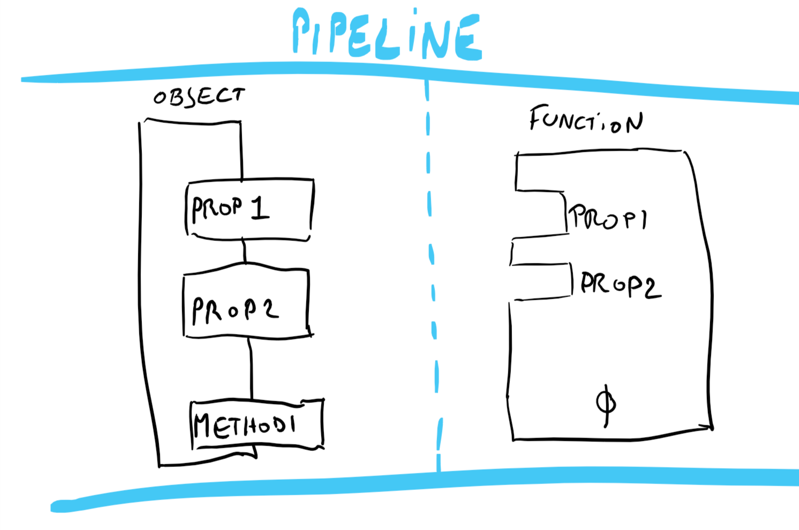
It’s all about the Pipeline

Slide 17
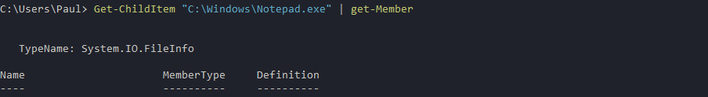
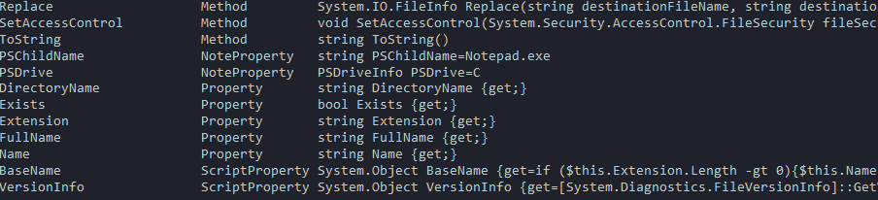
objects
Anatomy of an object:
Properties
Size
Length
Name
Methods
Trim()
ToString()

Slide 18
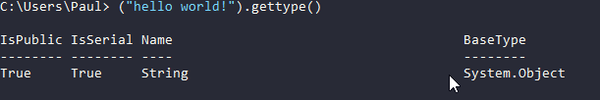
objects
EVERYTHING in PowerShell is an object

Slide 19
Creating your own objects
Create your own objects for output
Bend the output of other cmdlets to your will!

Slide 20
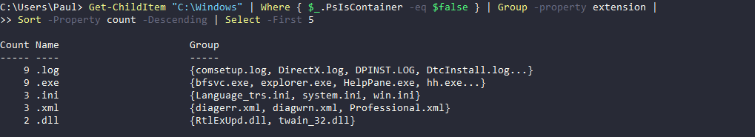
Use The pipeline
Most cmdlets use the pipeline
Code to use the pipeline
Allows cmdlets and functions to be chained together

Slide 21
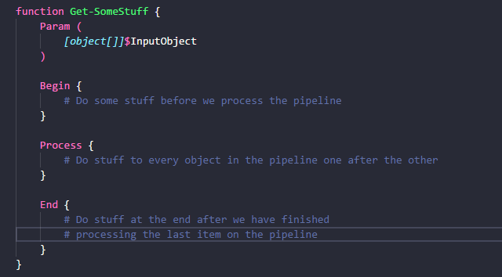
Use The pipeline
Code to use the pipeline

Slide 22
The powershell taste experience
Users expect your PowerShell to taste like PowerShell
Use common parameter names
-Path, -Computername, -Destination
Use singular and not plural naming
Get-Item, Get-ADUser, Add-AppxPackage

Slide 23
The powershell taste experience
Avoid Write-Host
Output objects

Slide 24
modules

Slide 25


Join the PSUG Slack TEAM
We’re here:
https://get-psuguk.herokuapp.com
Or
http://bit.ly/2eQyxOD

Slide 26
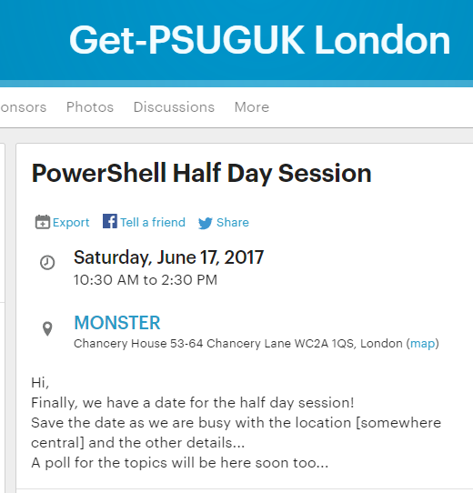
Other events Part 1
PowerShell Half Day
Saturday 17th of June
Track 1: Easy
Track 2: Intermediate

Slide 27

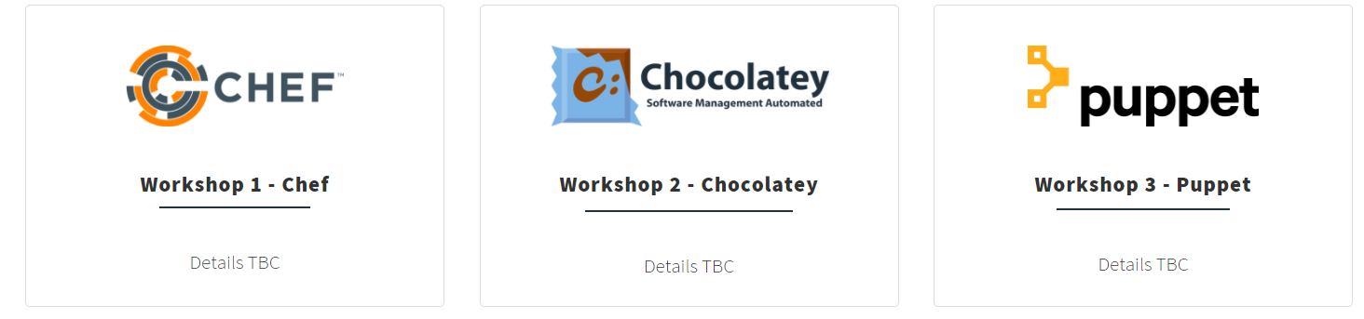
Other events Part 2
WinOps 2017
Wed 20 – Thr 21st September

Slide 28

resources
PowerShell Practice & Style Guide
https://github.com/PoshCode/PowerShellPracticeAndStyle
PowerShell + DevOps Global Summit 2017
PowerShell Conference EU
Azure Cloud Shell – PowerShell version in preview
http://aka.ms/pscloudsignup

Slide 29
Hurry up and move on!

